Slide 1

INSTITUTE UIE
DEPARTMENT ACADEMIC UNIT-1
Bachelor of Engineering (Computer Science & Engineering)
Subject Name Introduction Electrical & Electronics Engineering
Subject Code 23ECH-101
Prepared By
Dr. Shikha
Unit-2 Chapter-2
Multiplexer
Lecture No. 2.1.4
MULTIPLEXER
DISCOVER . LEARN . EMPOWER

Slide 2

Lecture Objectives
S. No. | Objectives
1 | To make student aware about the derivation of logic for the design of Multiplexer.
2 | To aware about implementation of Multiplexer circuit.
3 | To learn about design of different design of muktiplexer.

Slide 3
Course Objectives
S. No. | Objectives
1 | Understand Electrical & Electronics Engineering Fundamentals
2 | To prepare students to perform the analysis and design of various Electrical & digital electronic circuits.

Slide 4
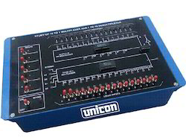
Course Outcome
CO Number | Title | Level
CO1 | To identify the different types of electrical elements and the basic op-amp circuit elements and to illustrate the various types of motors, transducers. | Remember
CO2 | To understand basic principles of transformers, transducers, op-amps, DC and AC motors and to compare the different methods for analysing electrical and magnetic circuits. | Understand
CO3 | To derive the relationships between parameters in electric and magnetic circuits and motors and to determine specifications of op-amps. | Analyze
CO4 | To solve the basic problems related to electric circuits, magnetic circuits and motors and to assess the characteristics of different configurations of op-amps. | Evaluate
CO5 | To design the different applications of transducers, motors as well as the op-amps like adders, subtractor and comparators. | Create
MULTIPLEXER

Slide 5
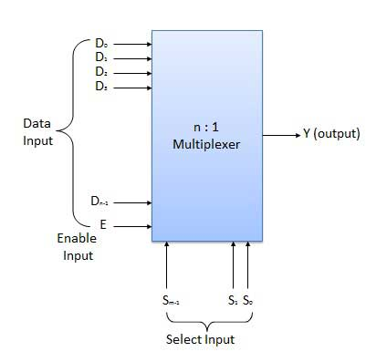
MULTIPLEXER
Multiplexer (MUX) means many to one .
n input lines
One output lines
m select lines
N= 2^{m}
Different types of MUXS:
2 : 1 multiplexer
4 : 1 multiplexer
16 : 1 multiplexer
32 : 1 multiplexer
64:1 MUX
Figure 1 General diagram of MUX

Slide 6
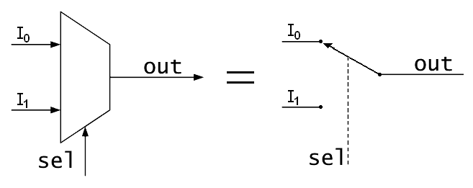
2:1 MUX
There are 2 input lines I_{0,} I_{1.}
There is one select lines S.
One output line.
Figure 2 Block diagram of 2:1 MUX

Slide 7
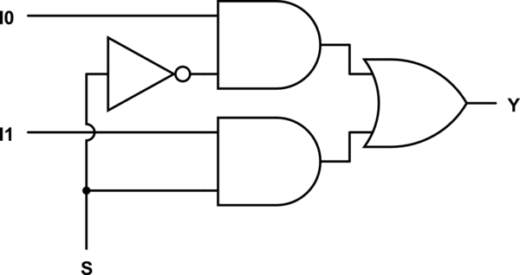
2:1 MUX
S = 0, Y = I₀
S = 1, Y = I₁
Boolean Expression the 2:1 MUX is
Y = S’I₀ + SI₁
Truth Table
S | Output
0 | I₀
1 | I₁
Figure 3 Logic diagram of 2:1 MUX

Slide 8
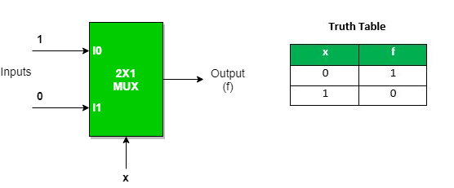
Implementation of NOT gate using 2 : 1 Mux
Multiplexer can act as universal combinational circuit. All the standard logic gates can be implemented with multiplexers.
We can analyze it Y = x’.1 + x.0 = x’ It is NOT Gate using 2:1 MUX. The implementation of NOT gate is done using “n” selection lines. It cannot be implemented using “n-1” selection lines. Only NOT gate cannot be implemented using “n-1” selection lines.

Slide 9
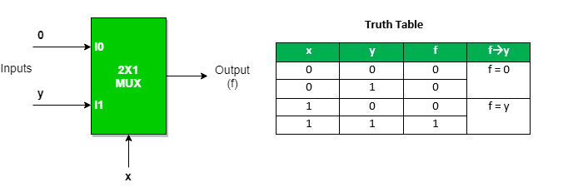
Implementation of AND gate using 2 : 1 Mux

Slide 10
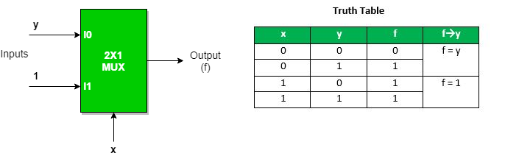
Implementation of OR gate using 2 : 1 Mux

Slide 11
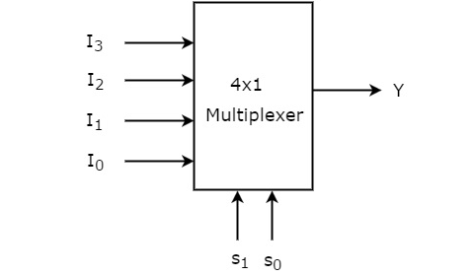
4:1 MUX
There are 4 input lines I_{0,} I_{1,} I_{2,} I_{3.}
There are two select lines S₀ , S₁
One output line.
Figure 4 Block diagram of 4:1 MUX

Slide 12
4:1 MUX
Truth table of 4:1 MUX
S₁ | S₀ | Output
0 | 0 | I₀
0 | 1 | I₁
1 | 0 | I₂
1 | 1 | I₃

Slide 13
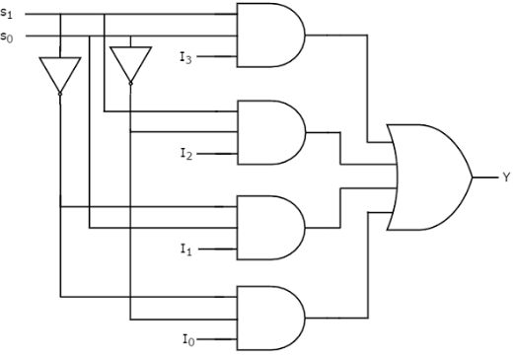
4:1 MUX
Figure 6 Logic diagram of 4:1 MUX

Slide 14
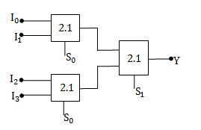
4:1 MUX using 2:1 MUX
Figure 7 Logic diagram of 4:1 MUX using 2:1 MUX

Slide 15
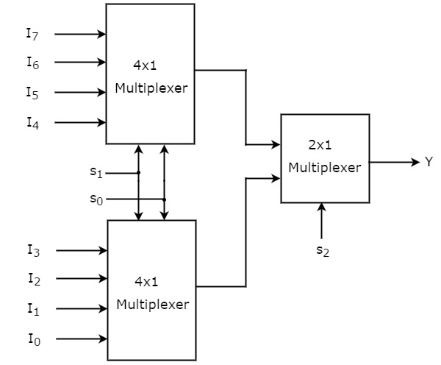
8:1 MUX using 2:1 and 4:1 MUX
Figure 8 Logic diagram of 8:1 MUX

Slide 16
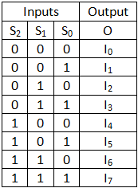

Slide 17
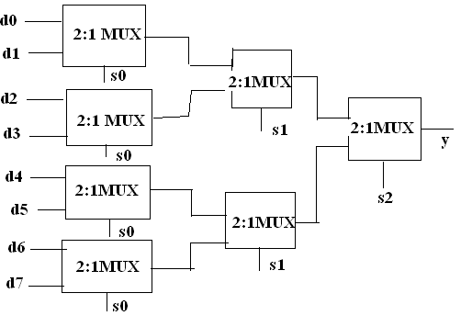
8:1 MUX using only 2:1 MUX
Figure 9 Logic diagram of 8:1 MUX

Slide 18
Questions:
Implement the following expression using MUX
Y(a,b,c)=∑m(0,1,6,7)
Y=A’BC’+AB’C’D+A’B’D+A’CD

Slide 19
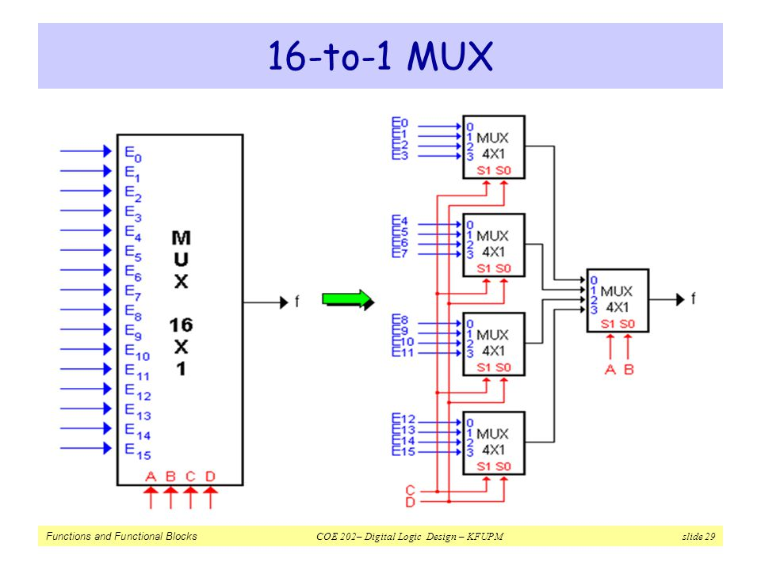

Slide 20
Assessment Pattern
Design a 8:1 multiplexer.
Design an 8:1 mux using 2:1 mux.
Design an 16:1 mux using 4:1 mux only.
Design an 16:1 mux using lower order mux.

Slide 21
APPLICATIONS
Used in Transmission o fDATA.
In selection of MEMORY in computers.
As a switch

Slide 22
REFERENCES
https://www.google.com/url?sa=i&url=https%3A%2F%2Fwww.indiamart.com%2Fproddetail%2Fmultiplexer-and-demultiplexer-trainer-9336916362.html&psig=AOvVaw3rvmgb8TYvQK2MTxMP2mes&ust=1595882004114000&source=images&cd=vfe&ved=0CAIQjRxqFwoTCKDo-fbh6-oCFQAAAAAdAAAAABAD
https://www.google.com/url?sa=i&url=https%3A%2F%2Flearn.circuitverse.org%2Fdocs%2FMSI%2Fmux.html&psig=AOvVaw1iWcVSERqtD9-mFibmInEQ&ust=1595882330875000&source=images&cd=vfe&ved=0CAIQjRxqFwoTCOiboojj6-oCFQAAAAAdAAAAABAJ
https://www.google.com/search?q=combinational+circuits+in+digital+electronics&source=lnms&tbm=isch&sa=X&ved=0ahUKEwj526-wnv3iAhWSXCsKHf77AtQQ_AUIESgC&biw=1366&bih=657#imgrc=v4c5n7-dy4fzAM
https://www.google.com/url?sa=i&url=https%3A%2F%2Fsimple.wikipedia.org%2Fwiki%2FMultiplexer&psig=AOvVaw2pebfxXNZxynKOvbTXhLiM&ust=1595884278300000&source=images&cd=vfe&ved=0CAIQjRxqFwoTCLD8mbzq6-oCFQAAAAAdAAAAABAE

Slide 23
REFERENCES
https://www.google.com/url?sa=i&url=http%3A%2F%2Fwww.vlsi-expert.com%2F2013%2F12%2Fdigital-basic-15-multiplexer-mux.html&psig=AOvVaw3xN1zjAPc331kKANSJ_As5&ust=1595886452950000&source=images&cd=vfe&ved=0CAIQjRxqFwoTCOCG_Ljy6-oCFQAAAAAdAAAAABAD
Mano,Morris, Digital Design, Prentice Hall of India.
Fletcher, An Engg. Approach to digital design, Prentice Hall of India.

Slide 24
THANK YOU

